Slide 1
MATLAB Image Processing Toolbox
Basic Introduction

Slide 2
Introduction
MatLab : Matrix Laboratory
A high-level language for matrix calculations, numerical analysis, and scientific computing
Programming
Can type on command line, or use a program file (“m”-file)
Semicolon at end of line is optional (suppresses printing)
Control flow (if, for, while, switch,etc) similar to C
Differences from C: no variable declarations, no pointers

Slide 3
Why MATLAB?
Shorter code, faster computation
Focus on ideas, not implementation
C: #include <math.h> double x, f[500]; for( x=1.; x < 1000; x=x+2) f[(x-1)/2]=2*sin(pow(x,3.))/3+4.56;
MATLAB:
f=2*sin((1:2:1000).^3)/3+4.56;
But: scripting language, interpreted, can be slow

Slide 4
What is the Image Processing Toolbox?
The Image Processing Toolbox is a collection of functions that extend the capabilities of MATLAB’s numeric computing environment.
This toolbox supports a wide range of image processing operations, including:
Geometric operations
Neighbourhood and block operations
Linear filtering and filter design
Transformations
Image analysis and enhancement
Morphological image operations
And many more….

Slide 5
Images in MATLAB
MATLAB can import/export several image formats:
BMP (Microsoft Windows Bitmap)
GIF (Graphics Interchange Files)
HDF (Hierarchical Data Format)
JPEG (Joint Photographic Experts Group)
PCX (Paintbrush)
PNG (Portable Network Graphics)
TIFF (Tagged Image File Format)
XWD (X Window Dump)
raw-data and other types of image data
Data types in MATLAB
Double (64-bit double-precision floating point)
Single (32-bit single-precision floating point)
Int32 (32-bit signed integer)
Int16 (16-bit signed integer)
Int8 (8-bit signed integer)
Uint32 (32-bit unsigned integer)
Uint16 (16-bit unsigned integer)
Uint8 (8-bit unsigned integer)

Slide 6
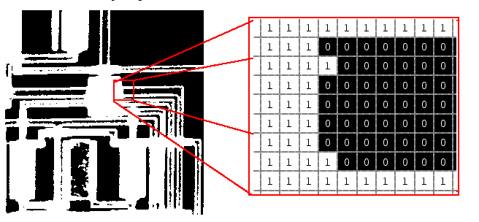
Images in MATLAB
Binary images: {0,1}

Slide 7
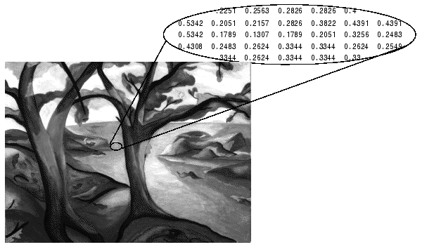
Images in MATLAB
Intensity images : [0,1] or uint8, double etc.

Slide 8
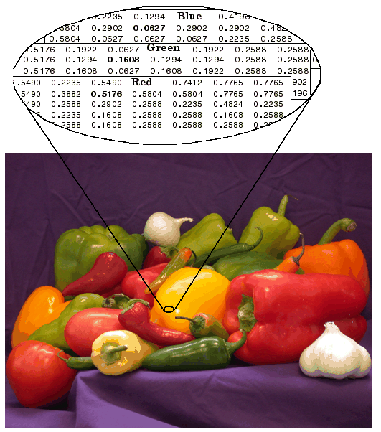
Images in MATLAB
RGB images : m × n × 3

Slide 9
MATLAB Image Coordinates
MATLAB stores images as matrices
In MATLAB, image pixels are referenced using (row, col) values
Origin of the coordinate system (1,1) is the top left corner of the image
img
Thus, img(4,3) refers to the pixel at the 4th row and 3rd column.

Slide 10
Image Matrix
By Default, MATLAB reads an image in uint8 (unsigned 8-bit integer) format
Each pixel has values in the range [0,255]
For some function you may need to convert image to double format
Double format has pixel values in the range [0,1]
To convert any image format to double, use MATLAB function “im2double()”
e.g.: A = imread(‘filename.extension’);
A_double = im2double(A);

